Slide 1
ORGANISATIONAL
BEHAVIOUR
CHAPTER-18
ORGANISATIONS

Slide 2
LEARNING OBJECTIVES
  Organization refers to the planned coordination of the activities of a number of people to achieve desired goals.
  Organization performs several functions in order to achieve desired goals.
  An organization is preceded by a design. Environment, strategy, technology and contingency factors are the key factors in a design
  Functional design, place design, product design, and multidivisional design are the popular designs adopted in organizations.
  Matrix design, networked design, virtual design and learning organization represent designs of the future.
  Certain decisions relevant to designs are use of staff officers, shape of organization, and structure flexibility.
  In addition to formal designs, there are informal organizations too.

Slide 3
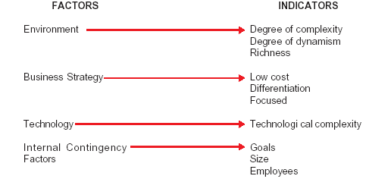
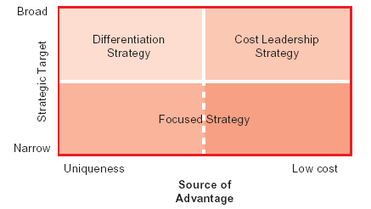
Key Factors in Design Decisions
Strategy Model

Slide 4
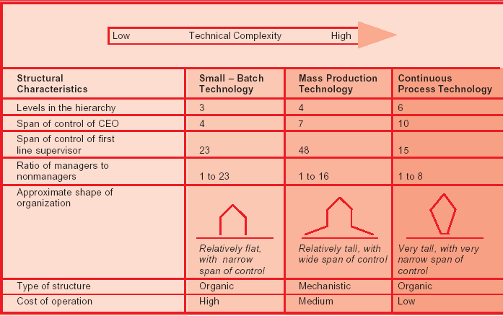
Technical Complexity and Organisation Design

Slide 5
Relationship Between Size and Design Dimensions
Basic Design Dimensions Small Organizations Large Organizations
Formalization Less More
Centralization High Low
Specialization Low High
Standardization Low High
Complexity Low High
Hierarchy of authority Flat Tall

Slide 6
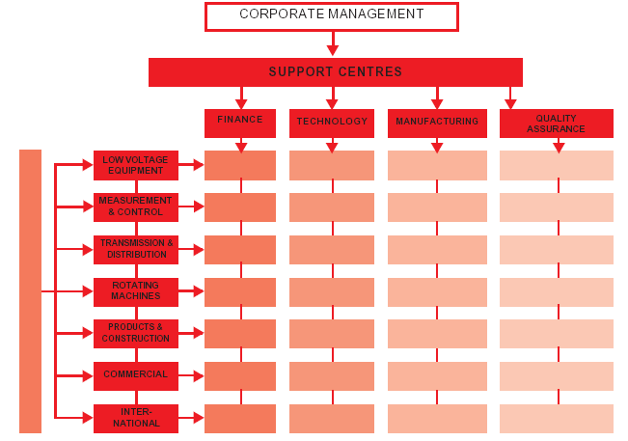
Matrix Design

Slide 7
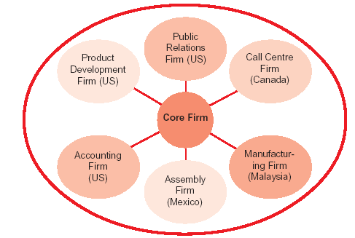
Networked Design

Slide 8
Traditional Versus Learning Organisation
Function Traditional Organization Learning Organization
Determination of overall Vision is provided by top There is shared vision that can emerge from
Direction management many places, but top management is responsible for ensuring that this vision exists and is nurtured.
Formulation and Top management decides what is Formulation and implementation of ideas take
implementation of ideas to be done, and the rest of the place at all level of the organization.
organization acts on these ideas.
Nature of organizational Each person is responsible for his Personnel understanding their own jobs as well
thinking or her own job responsibilities, and as the way in which their own work interrelates
the focus is on developing with and influences that of other personnel.
individual competence.
Conflict resolution Conflicts are resolved through Conflicts are resolved through the use of the use of power and hierarchical collaborative learning and the integration of influence diverse viewpoints of personnel through out the
organization.
Leadership and The role of the leader is to establish The role of the leader is to build a shared
motivation the organization’s vision, provide vision, empower the personnel, inspire
rewards and punishment as commitment, and encourage effective
appropriate, and maintain overall decisions making through out the enterprise
control of employee activities through the use of empowerment and charismatic leadership.

Slide 9
Need For Learning Organisation
Learning organization is essential because-
• Only it can survive tomorrow’s knowledge-based economy.
• Only it can manage tomorrow’s intense global competition.
• Only it can cope with tomorrow’s rapid fire technological changes
• Only it can handle tomorrow’s demanding and fragmented market
• Only it can build a people based work system in a company.

Slide 10
Characteristics of Mechanistic and Organic Structures²⁸
Organizational Characteristics Type of Organization Structure
Organic Mechanistic
Span of control wide narrow
Number of levels of authority few many
Ratio of administration to production personnel high low
Range of time span over which an long short
employee can commit resources
Degree of centralization in decision making low high
Proportion of persons in one unit having opportunity to high low
interact with persons in other units
Quantity of formal rules low high
Specificity of job goals low high
Specificity of required activities low high
Content of communications advice and instructions
information and decisions
Range of compensation narrow wide
Range of skill levels narrow wide
Knowledge-based authority high low
Position-based authority low high

Slide 11
Beauracracy
        Division of labour.
        Well defined hierarchy of authority.
        Clearly defined responsibilities and authority.
        Heavy dependence on formal rules and procedures.
        Employment decisions based on merit.
        Impersonality of relations.
        Promotions based on technical qualifications.
        Centralization of authority.

Slide 12
Difference Between Formal and Informal Organisation
Characteristics Informal organization Formal organization
1. Nature Unofficial Official
2. Communication Informal-grapevine Formal channels
3. Control mechanism Physical or social sanctions Threat of firing
4. Primary focus Person Position
5. Goals Member satisfaction Profitability
6. Source of leader power Given by group Delegated by management
7. Major concept Power and politics Authority and responsibility
8. Membership Only those “acceptable” All individual in work groups

Slide 13
Potential Problems and Benefits Associated With an Informal Organisation
Benefits Problems
• Makes an effective total system • Develops undesirable rumour
• Lightens work load on management • Encourages negative attitudes
• Helps get the work done • Resists change
• Tends to encourage co-operation • Leads to inter-personnel and inter-group conflicts
• Fills in gaps in a manager’s abilities • Develop role conflicts
• Gives satisfaction and stability to workforce • Rejects and harasses some employees
• Improves communication • Weakens motivation and satisfaction
• Provides a safety valve for employees emotions • Operates outside of management control
• Encourages managers to plan and act carefully. • Supports conformity

Slide 14
Summary
        Organization refers to the planned coordination of the activities of a number of people to achieve shared goals.
        Organizations perform several functions such as allocating resources; instructing employees, exert power and control, and the like.
        Organization designs and structures are the backbones for organizations.
        Several key factors determine organization designs.
        Functional design, place design and product design are important organization designs.
        Managers need to make several decisions relating to organization designs.
        Organization structures will impact employee behaviour considerably.

Slide 15
Key Terms
Organization
Organization structure
Place design
Matrix design
Virtual organization
Tall structure
Informal organizations
Organic structure
Organization design
Functional design
Product design
Networked design
Learning organization
Flat structure
Bureaucratic organization

